Slide 1
HARDWARE FUNDAMENTAL

Slide 2

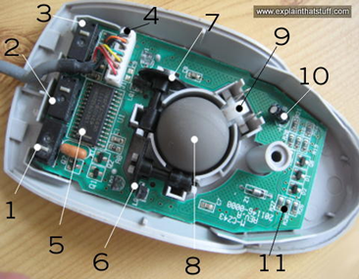
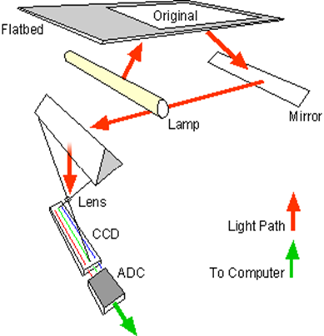
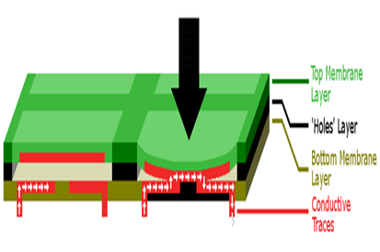
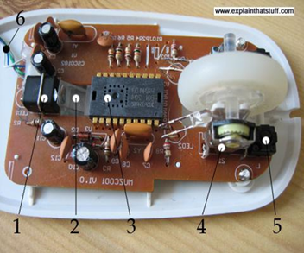
Input Devices
Keyboards | Mouse | Scanners
1.Mechanical Keyboard | 1.Mechanical mouse | 1.Flatbed scanner
2. Membrane Keyboard | 2. Optical Mouse
 |  | 2.Sheetfed Scanner
 |  | 3.Handheld Scanner
 |  | 4.Drum Scanner

Slide 3
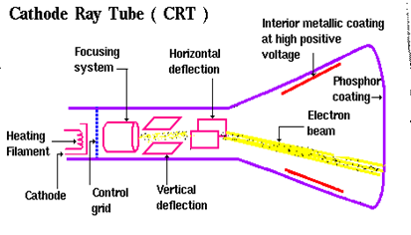
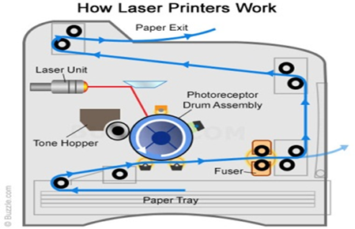
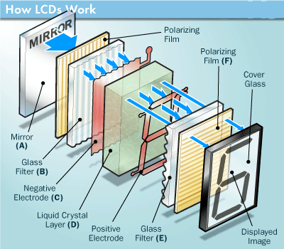
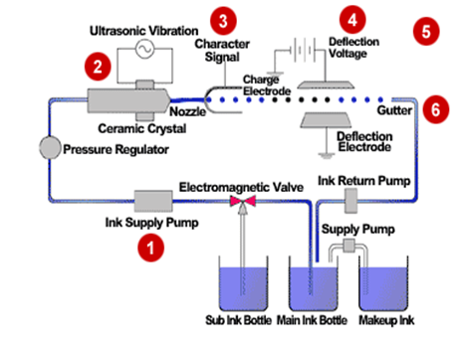
Output Devices
Monitors | Printers
1.CRT monitor | 1.Laser printer
2.LCD monitor | 2.Inkjet printer

Slide 4
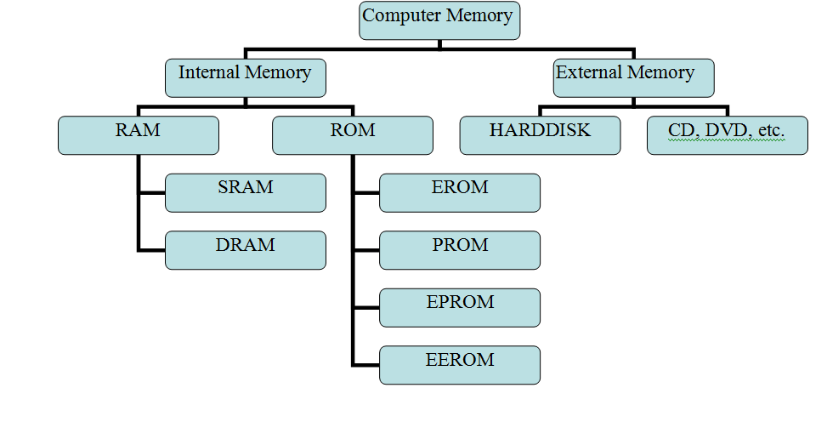
Memory Classification

Slide 5
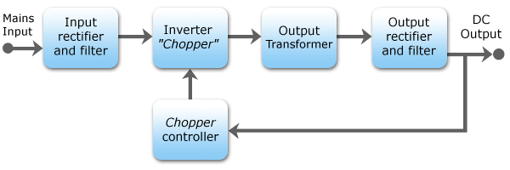
Power Supply
SMPS(Switch Mode Power Supply)
230v Ac supply

Slide 6
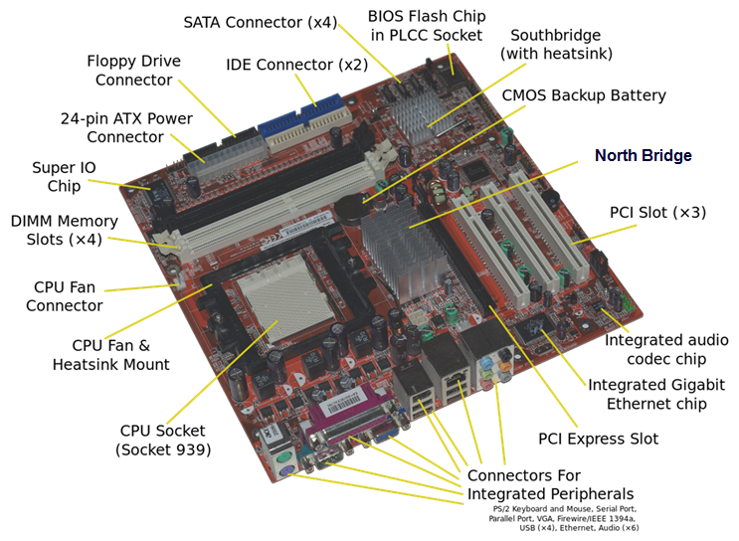
Motherboard

Slide 7
WINDOWS

Slide 8
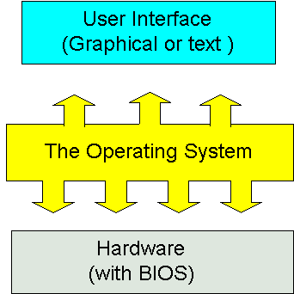
Operating System
An operating system (OS) is system software that manages computer hardware and software resources and provides common services for computer programs.

Slide 9
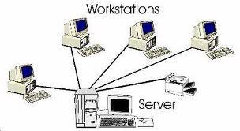
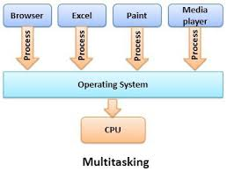
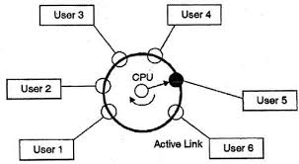
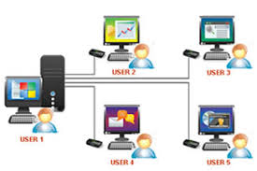

Types of Operating System
network
distributed
Real time
Multiuser

Slide 10
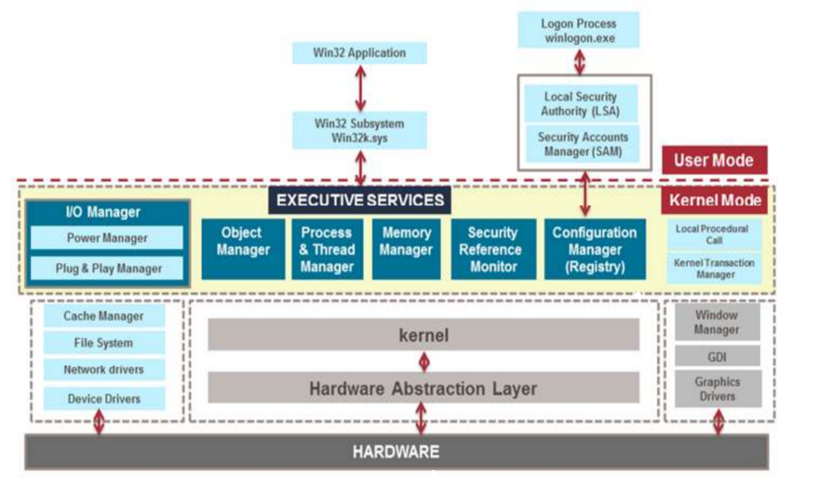

Kernel Architecture

Slide 11
Booting Process
BIOS
SMPS
PROCESSOR
BIOS
MBR
Boot Sector

Slide 12
Booting Process… OS LOADER
Boot Sector
Boot Manager
Boot Loader
Winload.exe
Winresume.exe (If hibernation is enabled)
Load Kernel
Ntoskernel.exe
Phase 0
Initialize Kernel
Initialize Hal.dll
Bootvid.dll
Phase 1
System Drivers

Slide 13
Booting Process… Session Initialization
SMSS.exe
CSRSS.exe
Wininit.exe
Winlogon.exe
LogonUI.exe

Slide 14
Booting Process… Explorer Initialization
LogonUI.exe
Loads registry
Desktop window manager
Initiates users
Explorer.exe
HKCU
dwm.exe
Userinit.exe

Slide 15
Memory Management
Memory Allocation:
Contiguous
Non-contiguous
Fixed Partition Size
Variable Partition Size
Memory Management Concepts:
Virtual Memory
Paging concept

Slide 16
LINUX

Slide 17
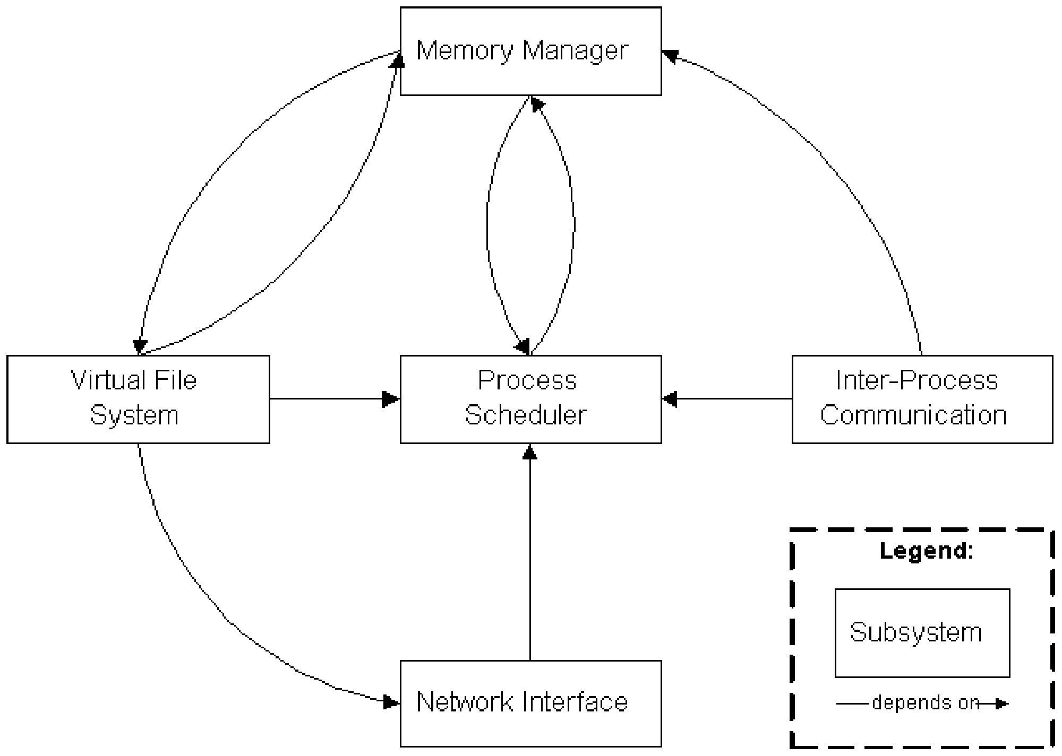
Linux Kernel Subsystem

Slide 18
Booting Process - Linux
SMPS
Grub Loads KERNEL Image
& initial Ram Disk
GRUB Reports Error 15: File Not Found
BIOS (POST)
Boot loader Stage 1
BIOS reports missing OS
Kernel Mount Root File System
Kernel Reports Panic / Freezes
Boot Loader Stage 1.5 then Stage 2
‘GRUB’ Displayed
Kernel runs Init / Run levels
Drop into root Shell
Init 3
Init 5
Menu.Lst
Drop into GRUB CMD Line
Init runs Script to start User Level Services
Boot-Time Menu

Slide 19
Types of Shell
B shell (Bash) - /bin/sh – This is the default Unix shell for many Unix operating systems .
C-shell /bin/csh was designed to provide the interactive features lacking in b shell such as job control and aliasing .
K shell /bin/ksh – was created by David Korn and has features of both B shell and C shell along with some additional features
.
Bash (Bourne again Shell) –.It is based on B shell language and has features of C and K shells.
tcsh (Tenex C Shell): Essentially it is C shell with programmable command line completion, command-line editing, and a few other features.
Zsh (Z Shell) is a shell designed for interactive use and it has many of the useful features of bash, ksh, and tcsh along with many new features.

Slide 20
Process Management
A process is a sequence of instruction in execution.
TYPES OF PROCESS
Interactive Process
Batch Or Automatic Process
Real Time Process
Zombie Process
PROCESS SCHEDULING
Scheduling refers to the way processes are assigned to run on the available cpu’s
FUNCTIONALITY OF SCHEDULER
CPU Utilization
Throughput
Turnarround
Waiting Time
Response Time
Fairness

Slide 21
Types of file system
S.no | EXT-2 | EXT-3 | EXT-4
1. | Ext2 stands for second extended file system. | Ext3 stands for third extended file system. | Ext4 stands for fourth extended file system.
 | It was introduced in 1993. | It was introduced in 2001. | It was introduced in 2008.
3. | This was developed to overcome the limitation of the original ext file system. | Starting from Linux Kernel 2.4.15 ext3 was available. | Starting from Linux Kernel 2.6.19 ext4 was available.
4. | Ext2 does not have journaling feature. | The main benefit of ext3 is that it allows journaling. | Supports huge individual file size and overall file system size.
5. | Maximum individual file size can be from 16 GB to 2 TB | Maximum individual file size can be from 16 GB to 2 TB | Maximum individual file size can be from 16 GB to 16 TB
6. | Overall ext2 file system size can be from 2 TB to 32 TB. | Overall ext3 file system size can be from 2 TB to 32 TB. | Overall maximum ext4 file system size is 1 EB (exabyte). 1 EB = 1024 PB (petabyte). 1 PB = 1024 TB (terabyte).

Slide 22
NETWORK FUNDAMENTALS

Slide 23
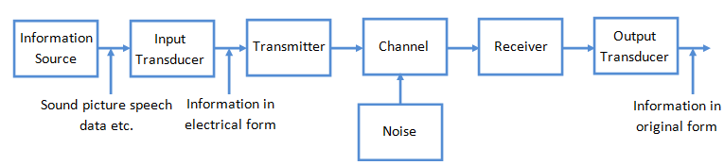
Components Of Communication

Slide 24
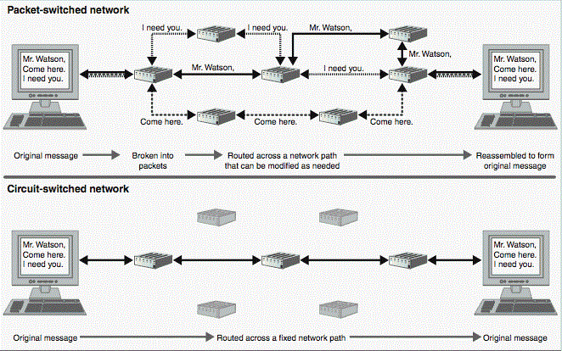
Fundamental Network Characteristics
Protocol
Circuit switching and Packet switching

Slide 25
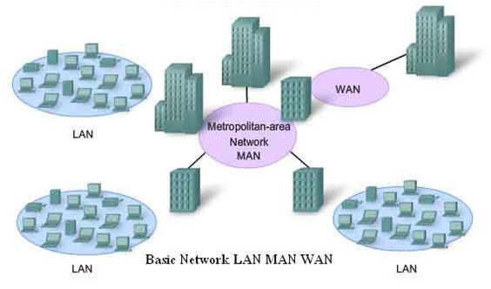
Network Types
LAN
MAN
WAN

Slide 26
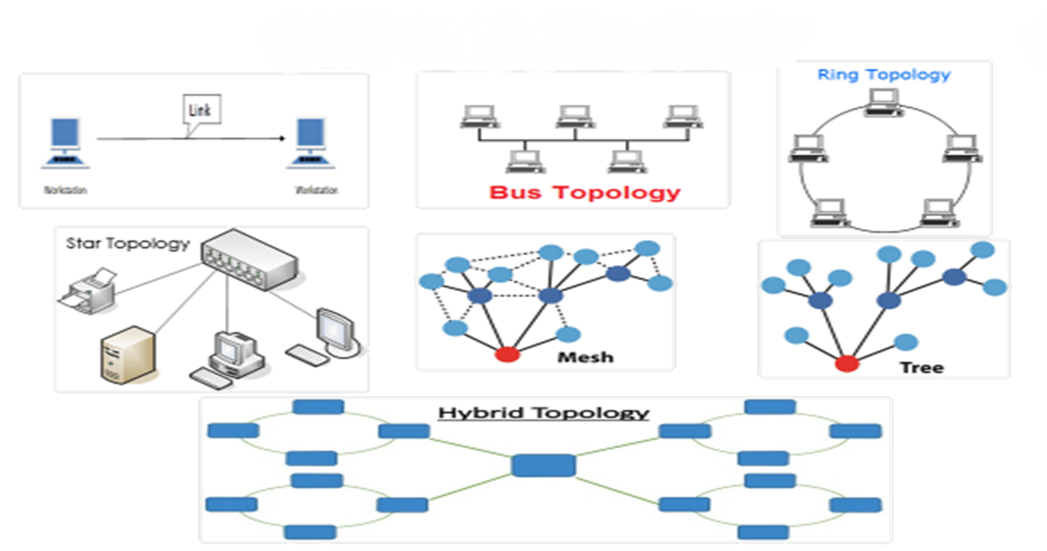
Network Topologies

Slide 27
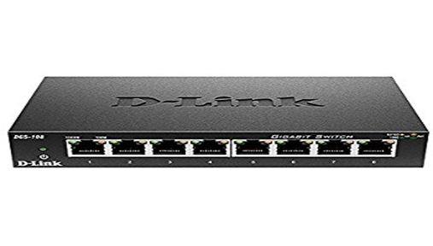
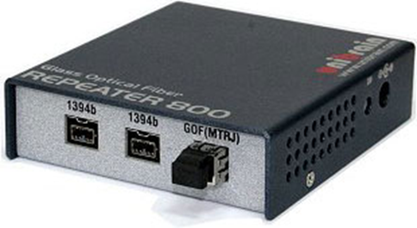
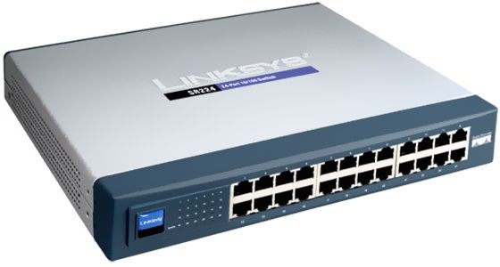
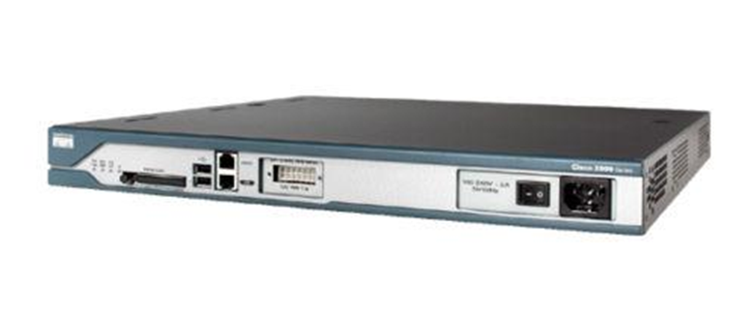
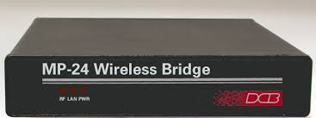
Network Devices
Switch
Repeaters
Hub
Router
Bridge

Slide 28
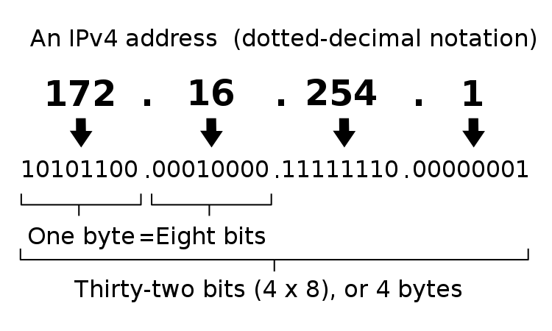
IP Addressing
IPv4

Slide 29
Subnetting:
Subnetting is a way of splitting a network into smaller, more manageable pieces.
purpose of subnetting is to help relieve network congestion.
Reserved Address
Link-local Addresses
169.254.1.0 to 169.254.254.255
Loopback IP Addresses
127.0.0.1 to 127.255.255.254
Private IP Address
10.0.0.0 to 10.255.255.255.
172.16.0.0 to 172.31.255.255.
192.168.0.0 to 192.168.255.255.

Slide 30
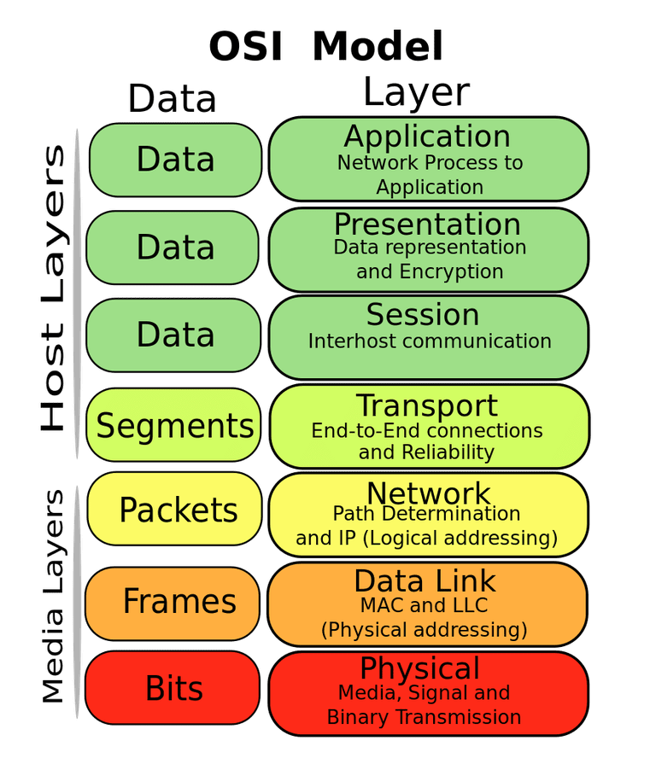
Open Systems Interconnection

Slide 31
NETWORK SERVICES

Slide 32
DHCP(Dynamic Host Configuration Protocol)
DHCP PROCESS
CLIENT
DISCOVER
SERVER
Client searching for DHCP Server
OFFER
DHCP Server sending offer to Client
REQUEST
Client request for IP from DHCP
ACKNOWLEDGMENT
DHCP Server assigned IP to Client and send Acknowledgement

Slide 33
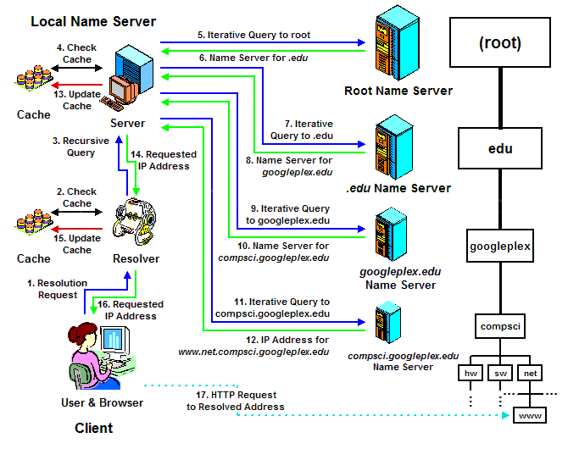
DNS

Slide 34
Directory Services
LDAP is an application protocol for querying and modifying items in directory service providers like Active Directory, which supports a form of LDAP.
It is an application protocol used over an IP network to manage and access the distributed directory information services.
It provides a systematic set of records, usually organised in a hierarchical structure.
LDAP is also used to store your credentials

Slide 35
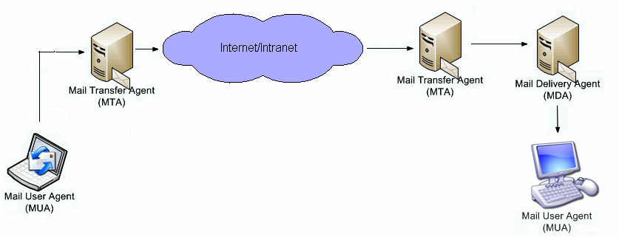
Mail Services
Components Of Email
Mail Transfer Agent
Mail Delivery Agent
Mail User Agent

Slide 36
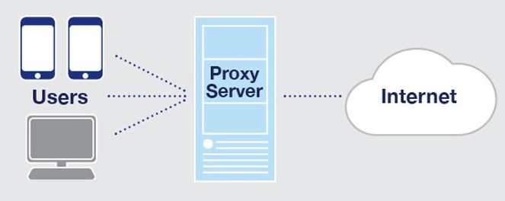
Proxy Server
Proxy server acts as an intermediate between client and server.
Types of Proxy Server:
Forward Proxy
Reverse Proxy

Slide 37
DATABASE FUNDAMENTALS

Slide 38
Database
Database are container for data which can be easily accessed, managed and updated.
History :
Hierarchical database
Network database
The network model builds on the hierarchical model by allowing many-to-many relationships
The hierarchical model organizes data into a tree-like structure, where each record has a single parent or root.
Relational database
The relational model sorts data into tables, also known as relations, each of which consists of columns and rows.

Slide 39
History count…
Object database
In which information is represented in the form of objects as used in object-oriented programming.
Object relational database
This hybrid database model combines the simplicity of the relational model with some of the advanced functionality of the object-oriented database model.

Slide 40
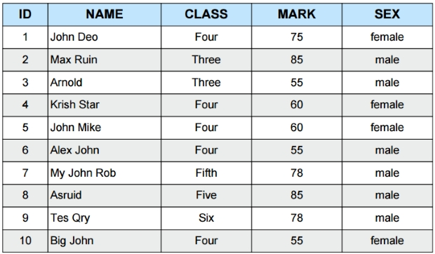
ACID Properties
1. A-Atomicity 3. I- Isolation
2. C-Consistency 4. D- Durability
Terminologies
Field
Attribute
Tuple
Domain

Slide 41
EF codd rules
Rule 1: Information Rule
Rule 2: Guaranteed Access Rule
Rule 3: Systematic Treatment of NULL Values
Rule 4: Active Online Catalog
Rule 5: Comprehensive Data Sub-Language Rule
Rule 6: View Updating Rule
Rule 7: High-Level Insert, Update, and Delete Rule
Rule 8: Physical Data Independence
Rule 9: Logical Data Independence
Rule 10: Integrity Independence
Rule 11: Distribution Independence
Rule 12: Non-Subversion Rule

Slide 42
Normalization
1NF-First Normal Form
Each set of column must have a atomic value.
2NF-Second Normal Form
There must not be any partial dependency of any column on primary key.
3NF-Third Normal Form
Third Normal form applies that every non-prime attribute of table must be dependent on primary key.
Transitive functional dependency should be removed
BCNF
R must be in 3rd Normal Form
and, for each functional dependency ( X → Y ), X should be a super Key.

Slide 43
General Architecture of DBMS
Application Layer:
Sophisticated User
Specialized User
Naïve Users
Database Administrator
Logical Layer:
Physical Layer:

Slide 44
Logical Modules Of RDBMS
Query Processing
Transaction
Management
Recovery
Management
Storage Management

Slide 45
APPLICATION FUNDAMENTALS

Slide 46
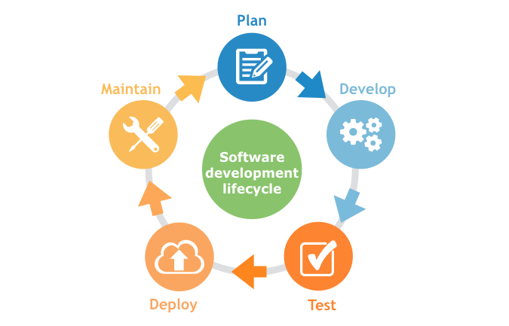
Components of Application
Presentation Logic
Business Logic
Data Persistence Logic
Life cycle of Application

Slide 47
Types of Application
Compiled
Interpreted
API
An application program interface (API) is code that allows two software programs to communicate with each other.
Application Architecture
Thick client architecture
Thin client architecture
Rich internet application

Slide 48
STORAGE FUNDAMENTALS

Slide 49
Storage
Storage is a process through which digital data is saved within a data storage device by means of computing technology.
Factors driving data storage demand:
Capacity
Performance
Availability
Scalability
Cost

Slide 50
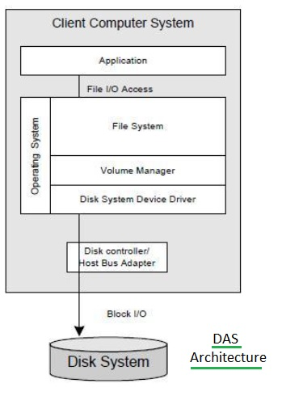
Storage Model
Direct Attached Storage (DAS):
It consists of computers that is directly connected to one or several hard disk drives (HDDs) or disk arrays.

Slide 51
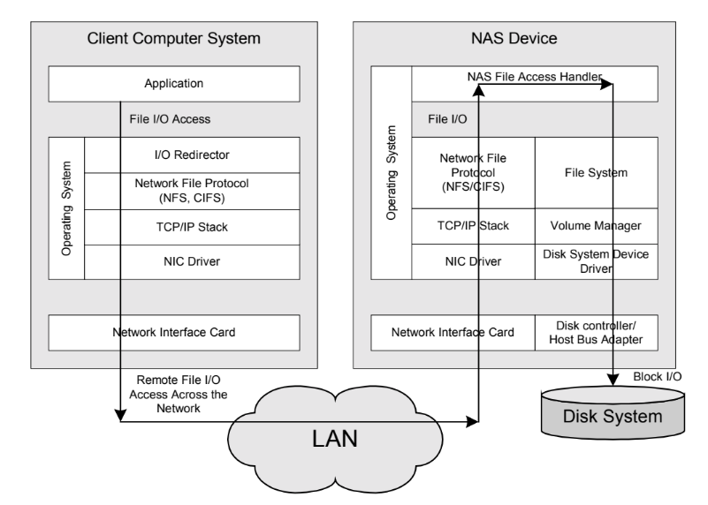
Network Attached Storage (NAS) NAS is generally referred to as storage that is directly attached to a computer network (LAN) through network file system protocols such as NFS and CIFS.
Storage Model…

Slide 52
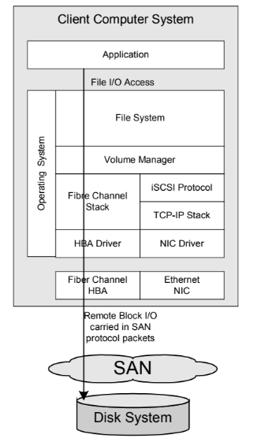
SAN-Storage Area Network:
Storage Model…

Slide 53
RAID Levels
Redundant Array of Inexpensive Disks
Basic idea is to connect multiple disks together to provide:
large storage capacity
faster access to reading data
redundant data

Slide 54
RAID Level-0
file data
block 0
block 1
block 2
block 3
block 4
0 block 0
1 block 2
2 block 4
3
4
5
0 block 1
1 block 3
2
3
4
5
sectors
sectors
Disk 0
Disk 1

Slide 55
RAID Level-1
file data
block 0
block 1
block 2
block 3
block 4
0 block 0
1 block 1
2 block 2
3 block 3
4 block 4
5
0 block 0
1 block 1
2 block 2
3 block 3
4 block 4
5
sectors
sectors
Disk 0
Disk 1

Slide 56
RAID Level-2
file data
block 0
block 1
block 2
block 3
block 4
Data Disk
Data Disk
ECC Disk
ECC Disk
Parity Disk

Slide 57
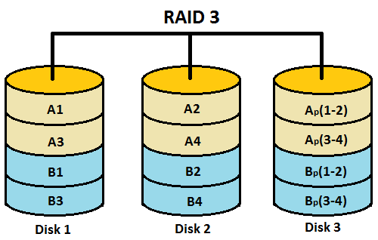
RAID Level-3

Slide 58
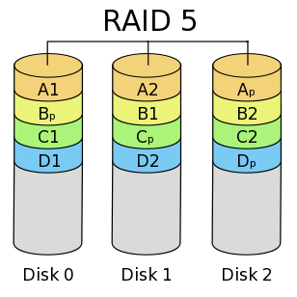
RAID Level-5

Slide 59
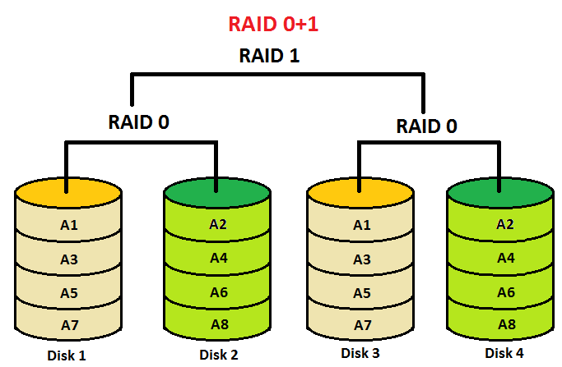
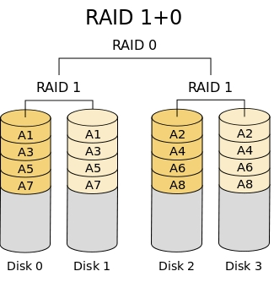
RAID Level- 1+0 & 0+1

Slide 60
Thank you

